Slide 1

NDT for the eVTOL Sector
Testia Ltd.
Matthew Day
Technical Sales Manager

Slide 2
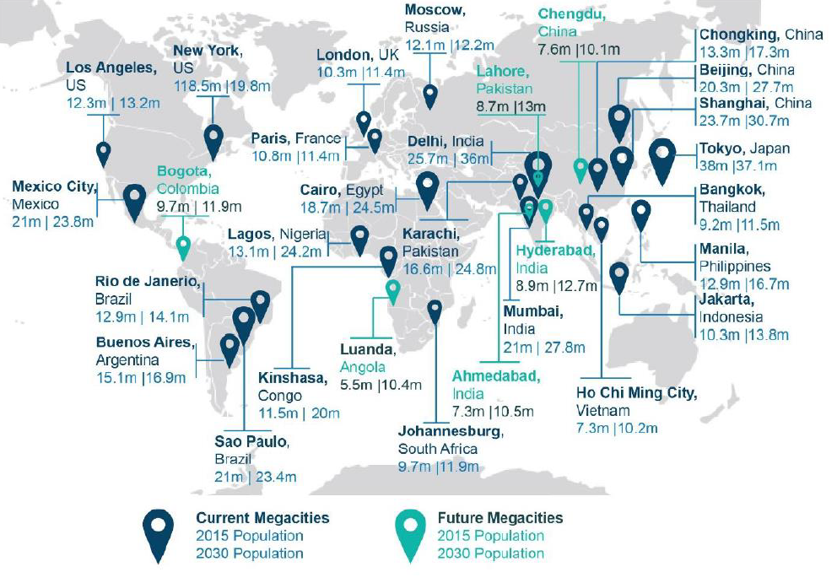
future demand fuelled by megacities (2015-2030)
Summary
Global population is projected to peak at 9.7 billion by 2064 before declining back to 8.8 billion by the end of the century. Population growth in the urban environment is projected to increase exponentially until 2030, expanding existing cities and creating the need for new megacities. Land traffic is increasing and existing infrastructure is close to capacity in many areas, with further expansion being prohibitively expensive.
Therefore there is a need for advancements in modes of transport that are not constrained by land based infrastructure. The need for quick, efficient, short range transport is increasing and with growing populations in urban environments, transport needs to be energy efficient and environmentally friendlier that land based alternatives and quick.
A growing number of companies are investing in research and development of eVTOL (electric Vertical Takeoff and Landing) aircraft as passenger air vehicles. Able to operate within the urban environment and without the constrains of land based infrastructure. The first eVTOL Air Taxi’s are expected to enter service by 2022-23.
Today cities around the globe are signing up to Smart-City partnerships to study the implementation of mobility solutions with an aim to improve autonomous aerial urban mobility.

Slide 3
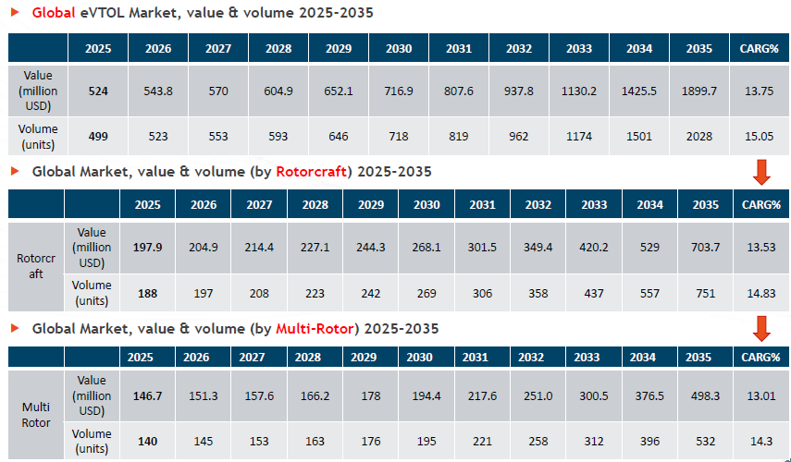
E-vtol Market value
With the first eVTOL aircraft coming to market in 2022-23 the projected market value is set to increase over a 10 year period by over $1.3billion. With over 2000 vehicles in service by 2035.
Today 139 companies are vying a position in this market where:
45% are at initial design phase
24% Scaled prototype
24% flight test
1% In service
5% abandoned projects
Catagorised as Intracity and Intercity the capacities of both are approximated below:
Intracity
  Range: 20 miles
  Cruise speed: 50 mph
Intracity
  Range: 70 – 690 miles
  Cruise speed: 50 – 150 mph

Slide 4
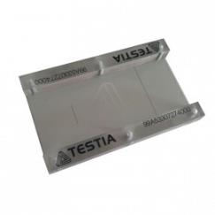
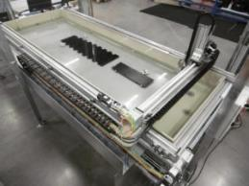
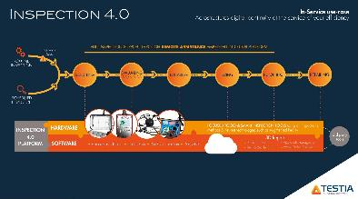
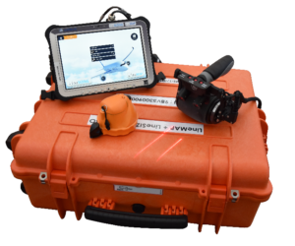
ndt solutions for e-vtol market
While a relatively young market in its own right, the eVTOL industry can benefit from the current NDT practices in Aerospace. Developments driven by both customer and OEM’s and the advancements in technology around I4.0
Reference Standards
Metallic & Composites
Known thresholds, POD & inspection cycles
Inspection & equipment
Infrastructure already exists & Globally positioned
Training
Established training programs
Smart Technology
Remote assistance
Multi-method NDT equipment
EN4179 & PCN Aero
OEM led training
Readily available

Slide 5
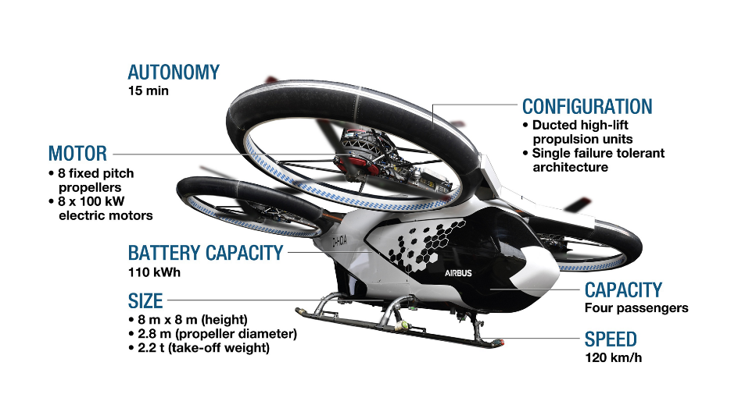
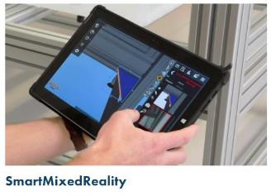
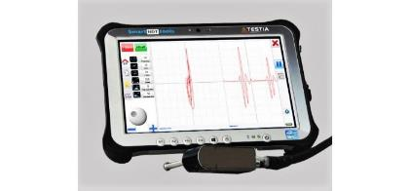
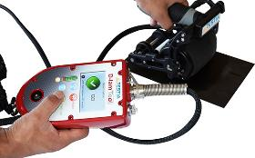
ndt solutions for e-vtol prototypes
Consultation
Design for inspection
BVID
Reference Standards
Requirements
Light weight airframe to counteract size and weight of batteries
Production of maintenance manuals
Smart equipment that integrate with continuous monitoring systems
Interest in Structural Health Monitoring
Remote monitoring with the potential for remote inspections
Quick easy screening of impact damage
Equipment
Off the Shelf products that are readily available for general inspection
“Smart” Solutions that reduce inspection end-to-end process
Go-No/Go bespoke equipment development
Written Techniques
Bespoke techniques dedicated for the inspection of lightweight structures and rotor blades by an approved organisation

Slide 6

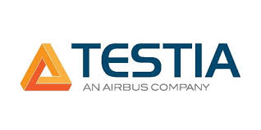

Conclusion
The eVTOL market is a growing industry which is still in its infancy.
eVTOL’s are set to complement the already mature aerospace industry as a conduit between airports and urban environments.
While the aircraft will be mostly autonomous, this does not mean that they are free from the risks of damage during take-off, flight & landing.
There will be a need to filter down some NDT screening techniques eg Go/No-Go gauges, for day to day activities. As these will be passenger carrying aircraft the requirements for NDT by trained and qualified inspectors will not disappear.
Smart Solutions that can monitor and feedback issues with airframe, motors, electrical systems and rotors are also in its infancy but the industry is waiting and expecting.
OEMs are racing to complete prototype stage and gain Aviation Authority approval. NDT at this stage is an investment for the future, being part of a growing market that takes all the experiences gained throughout the history of aerospace and apply it with a 4.0 technology.

Slide 7
